Slide 1
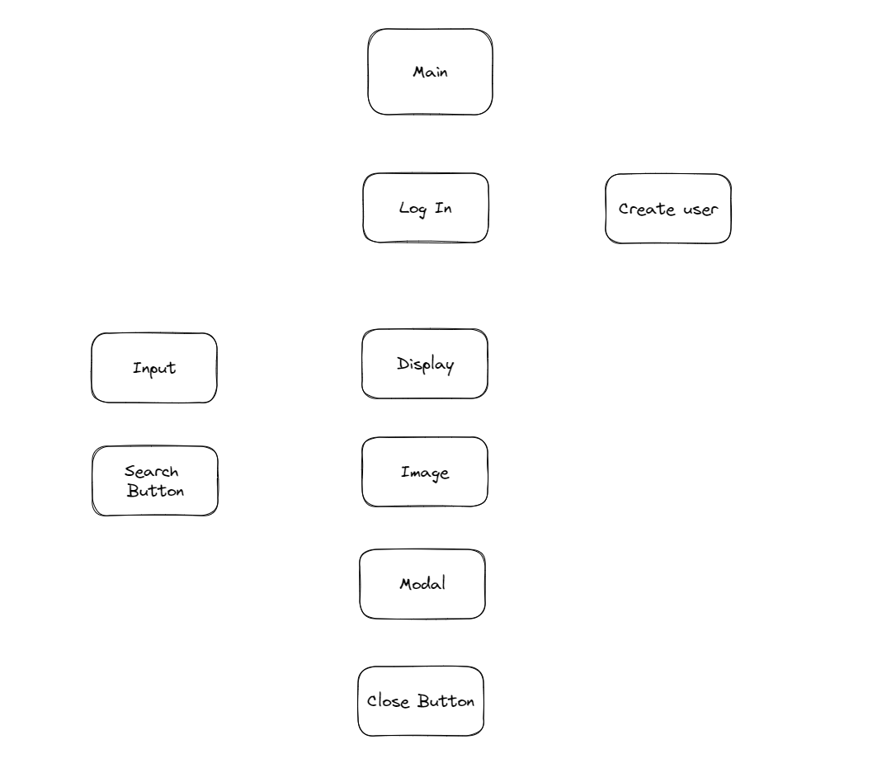
Normal user

Slide 2
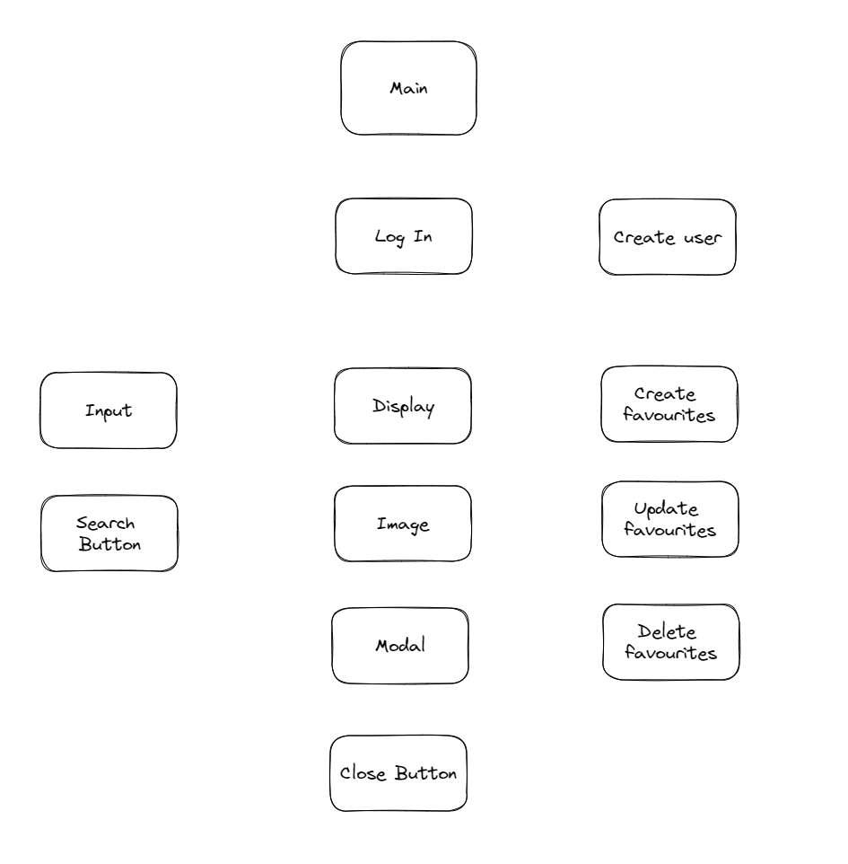
Admin user

Slide 3
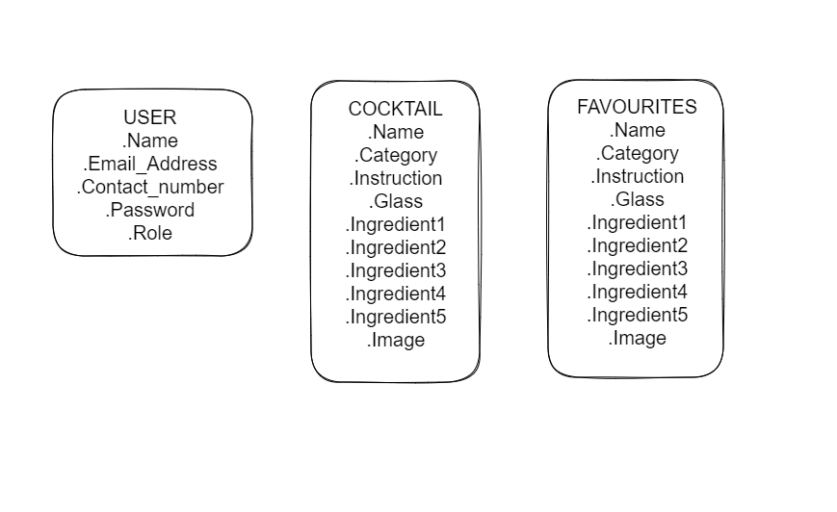
Database

Slide 4
Header
Please Log in to continue
Login Button

Slide 5
Header
Input search
Search Button
List of cocktails

Slide 6
Header
Back Button
Cocktail image
Cocktail Recipe

Slide 7
Header
Input search
Search Button
Favourites Button
List of cocktails

Slide 8
Header
Back Button
Add to favourites
Delete favourites
Cocktail image
Cocktail Recipe

Slide 9
Header
Input search
Search Button
Favourites Button
List of Favourites

